Slide 1
Air Sensor

Slide 2
Current Setup
Arduino Nano
(microcontroller)
ESP8266 WiFi module
(microcontroller)
Serial Communication
Sensor 1
Sensor 2
Node JS Server
Sensor N
REST API
Web Interface

Slide 3
Components
Arduino Nano
Web site: https://www.arduino.cc/en/Main/ArduinoBoardNano
Price on Amazon: $13.99
I/O Pins: 14 Digital (2 used for communication with ESP8266) and 8 analog
Code available here (you would need a bitbucket.org account)
ESP8266 WiFi module
I used Adafruit HUZZAH implementation of the module. See more details here.
Has it own microcontroller
Current price: $9.95 (different implementation could be found with price as low as $3)
Code available here (you would need a bitbucket.org account)
Sensors – TBD
What kind of air quality indices we are measuring? What sensors do we need?
Currently, I just used accelerometer for testing
Node JS Server
REST API implemented with Node JS, Express JS, and Moongose modules. Mongo DB for storage
Simple Web UI to browse sensor`s data
Code available on Github
If the future, we would need a hosting

Slide 4
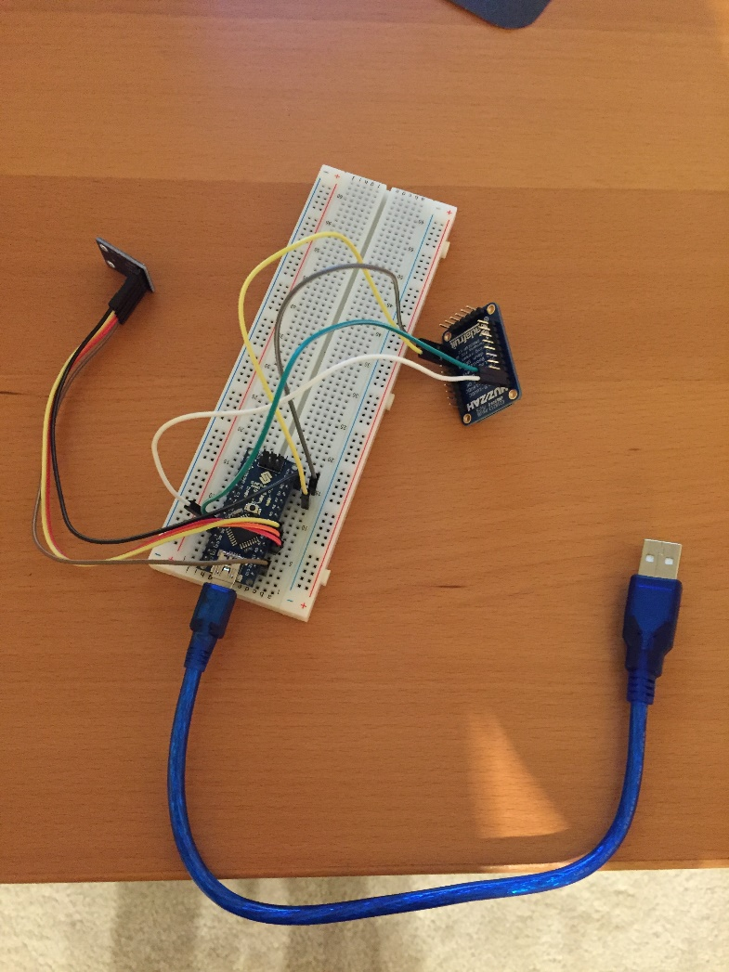
What do we need?
Sensors. We need to find out what kind of sensors we need.
Power supply. We can probably use a battery pack (5-6V).
A water proof cover or frame for the device + a small fan to get fresh air closer to the sensors
Hosting for REST API server
Anything else that I am missing?

